Slide 1
JBOSS EAP 7.3 – Architecture

Slide 2
A brief on few J2EE terminologies
Jar – Java Archive - Group of .class files (jar tf filename.jar)
War – Web Archive – Will have web-related J2EE components like
Servlets
JSP
HTML
CSS
JS
XML
EAR file is Enterprise archive
EAR has web related components and other non-web J2EE components as well
Web servers – used for web related projects
Application servers – used for web related and non-web related J2EE projects.

Slide 3
Why we need a Enterprise application platform
For developing web and non-web related Enterprise applications.
An open-source enterprise application platform like JBoss encompasses an application server
Has benefits like:
Flexible architecture
Rapid processing
Modularity
Management flexibility
JBOSS Application Server (AS) has been renamed to Wildfly in the EAP 7 version
Has a lot more capabilities which provides the ability to develop a sophisticated, flexible and robust applications.

Slide 4
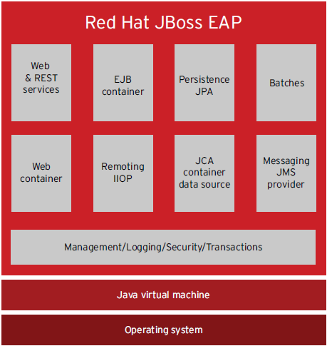
Architecture

Slide 5
Features and Capabilities explained
A web container is the component of a web server that interacts with Java servlets. A web container is responsible for managing the lifecycle of servlets
Messaging JMS - The new messaging subsystem is based on Red Hat’s unified messaging technology, Apache ActiveMQ Artemis (HornetQ in JBoss EAP 6)
RESTful basically works on the HTTP web layer(POST,GET,PUT etc) and uses the below key verbs to work with resources on the server
JCA - Java Connector Architecture (JCA) - standard architecture for Java EE systems to (ERP) systems, mainframe transaction processing (TP), databases, and messaging systems
Batches - JBeret provides an open-source Java batch processing framework to provide portable batch processing support in Java EE environment.
Persistence JPA - The Java Persistence API (JPA) is a Java specification for accessing, persisting, and managing data between Java objects or classes and a relational database.
Remote IIOP - IIOP (Internet Inter-ORB Protocol) - JBoss EAP supports CORBA/IIOP-based access to EJBs deployed on JBoss EAP.
EJB Container – Container for EJB objects creation and management

